Slide 1
Stratosphere-Troposphere Exchange
Vasura Jayaweera & Luke McFadden

Slide 2
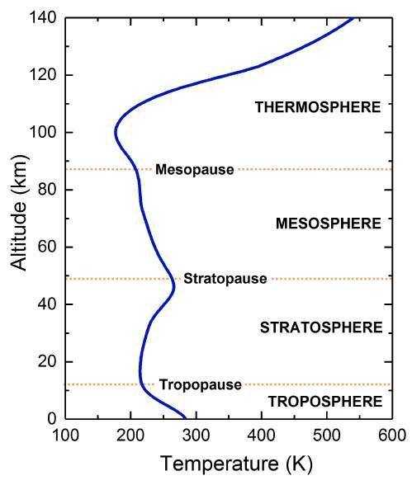
Troposphere and Stratosphere
Troposphere
8 – 18 km above surface
15 C down to -50
Contains 85% of atmospheric mass
Most of the water vapour
Stratosphere
Between the tropopause and 50 km
Presence of ozone

Slide 3
Global Atmospheric Circulation
Differential heating on the surface causes warmer air to rise through convection and reaches the top of the troposphere.
Accumulated air will eventually cool and descend towards the surface thus reaching the equator as easterlies.
This type of circulation is referred to as cells.
The circulation of our planet can be represented by a three-cell model.

Slide 4
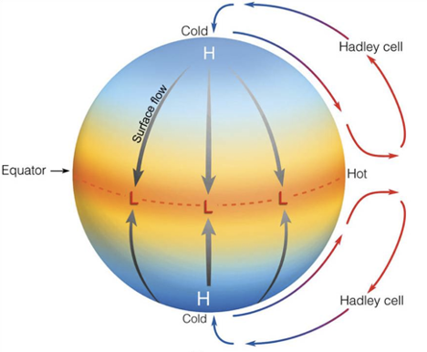
Original Hadley Cell
Hadley proposed wind observations were from a single cycle from the equator to the poles.
Matched observations but was later found to be inconsistent for the mid latitudes.
Ignored the Coriolis effect.

Slide 5
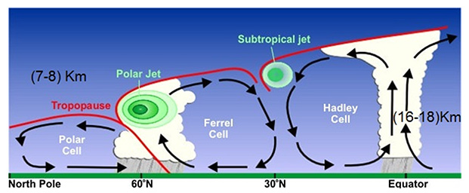
Ferrel and Polar Cell
William Ferrel (1817-1891) - accounted Earth’s rotation in wind systems.
Provide explanations to the reverse circulation that was observed in the midlatitudes.
Ferrel cells are not driven by temperature.
Polar Cell – Driven by surface temperatures.
Smallest and weakest cell extending between 60° and 70° latitude.

Slide 6
Simulations
We use Energy2D – a two-dimensional heat transfer simulation interface
We modify the original Hadley cell example project to learn more about cell formation
We use constant-temperature “blocks” to represent surface temperatures, with higher temperatures at the equator

Slide 7
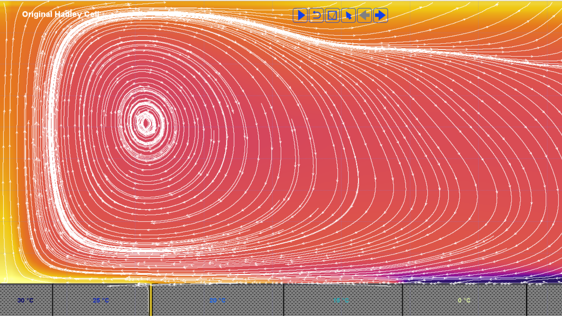

Slide 8
Three Cell Circulation
The Coriolis effect adds forces depending on your latitude
The north-south component of these were simulated by adding winds

Slide 9
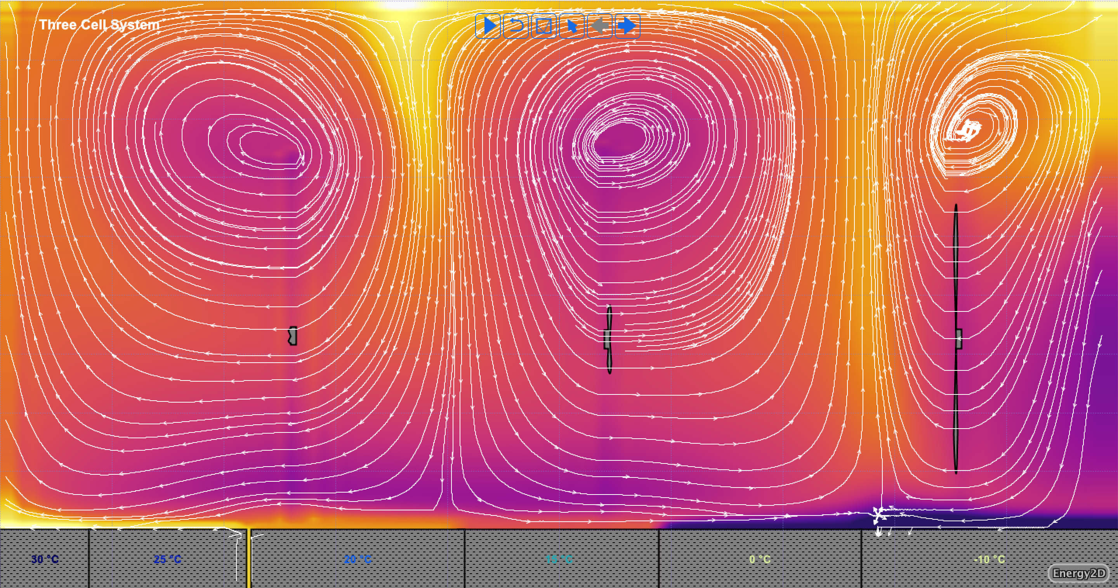

Slide 10
More Realisitc Hadley Cell
We observe a larger Northern Hadley cell when the Northern Hemisphere is in Winter
Land/Ocean ratio higher in the North, different surface temperatures

Slide 11
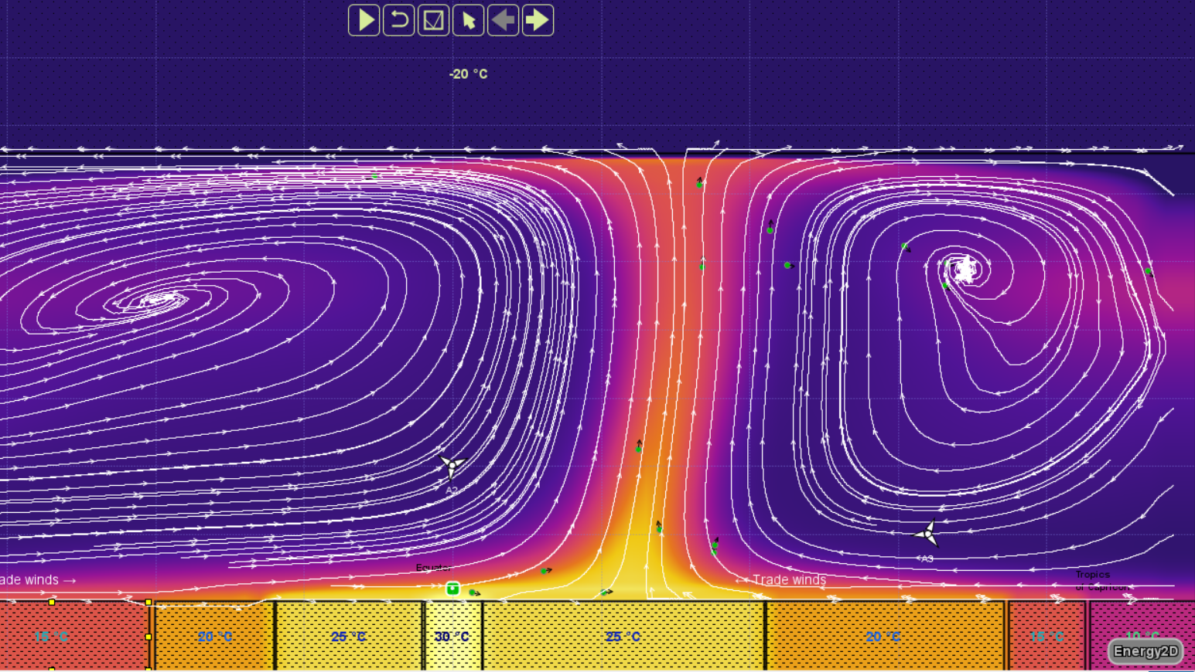

Slide 12
Conclusion
Circulation is responsible for mass transport between the stratosphere and the troposphere
A (simple) three-cell structure can be explained by the differential heating and Coriolis forces

